Slide 1
Opportunities and Challenges of the N* Programme
Theory Support for the Excited Baryon Program at the Jlab 12- GeV Upgrade. I. Aznauryan et al. JLAB-PHY-09-933, Jul 2009. 53pp. Presented at Electromagnetic N-N* Transition Form Factors Workshop, Jefferson Lab, Newport News, Virginia, 13-15 Oct 2008. e-Print: arXiv:0907.1901 [nucl-th]
References | LaTeX(US) | LaTeX(EU) | Harvmac | BibTeX | Keywords |
Abstract and Postscript and PDF from arXiv.org
JLab Document Server
Bookmarkable link to this information
Craig Roberts
Physics Division
Notes:
08:45-09:20 = 30+5

Slide 2
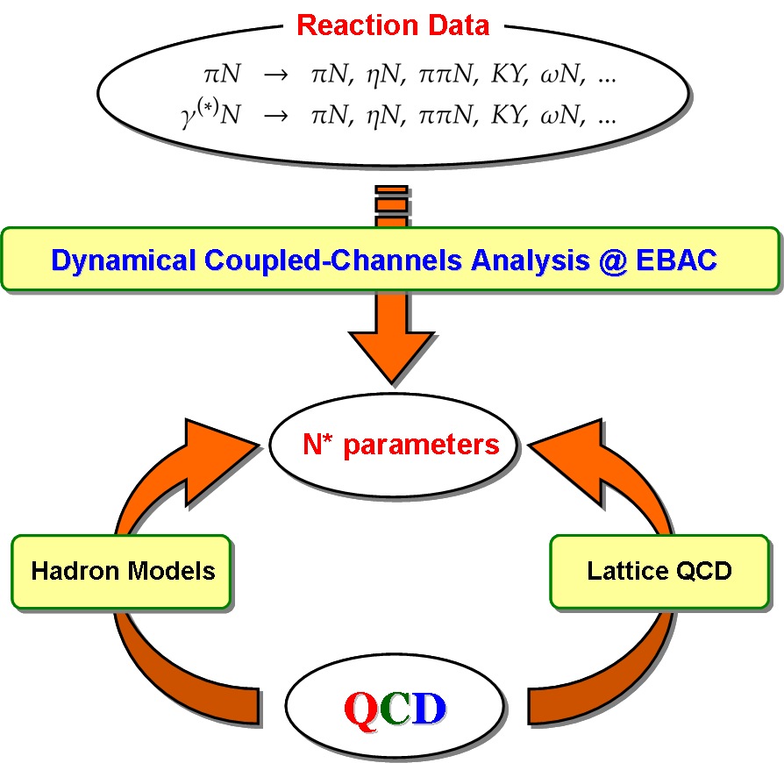
Missing Resonances? Hybrids & Exotics
Dynamical Coupled-Channels Analysis @ EBAC
Truly … the question:
“Which hadron states and resonances are produced by QCD, the strongly-interacting part of the Standard Model?”
Hadron Models
Nonp-QCD
Develop reaction theory that enables extraction of reliable information on resonance parameters and transition form factors
Relate information on resonances and related
transition form factors to the non-perturbative,
strong interaction mechanisms, that are responsible
for resonance formation
Understand …
how the interactions between dressed–quarks
and –gluons create ground & excited nucleon states;
how these interactions emerge from QCD

Slide 3
Theoretical Tools
Highlights of Progress
made since April 2009,
NStar2009 – Beijing
Constituent-quark and algebraic models
de Teramond
Matagne
Santopinto
Dyson-Schwinger equations
Cloët
Roberts
Generalised parton distributions
Vanderhaeghen
Lattice regularised QCD
Alexandrou
Wallace
Light-cone sum rules
Braun
Reaction models and theories
Jido
Krewald
Lee
Mosel
Sarantsev
Sato
Tiator

Slide 4
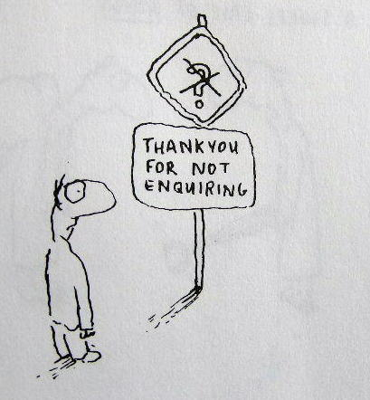
QCD’s Challenges
Understand emergent phenomena
Quark and Gluon Confinement
No matter how hard one strikes the proton,
one cannot liberate an individual quark or gluon
Dynamical Chiral Symmetry Breaking
Very unnatural pattern of bound state masses;
e.g., Lagrangian (pQCD) quark mass is small but
. . . no degeneracy between J^{P}=+ and J^{P}=− (parity partners)
Neither of these phenomena is apparent in QCD’s Lagrangian Yet they are the dominant determining characteristics of
real-world QCD.
QCD
– Complex behaviour arises from apparently simple rules.

Slide 5
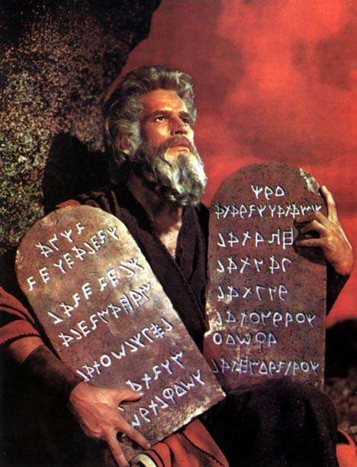
Universal Truths
Hadron spectrum, and elastic and transition form factors provide unique information about long-range interaction between light-quarks and distribution of hadron's characterising properties amongst its QCD constituents.
Dynamical Chiral Symmetry Breaking (DCSB) is most important mass generating mechanism for visible matter in the Universe.
Higgs mechanism is (almost) irrelevant to light-quarks.
Running of quark mass entails that calculations at even modest Q² require a Poincaré-covariant approach.
Covariance requires existence of quark orbital angular
momentum in hadron's rest-frame wave function.
Confinement is expressed through a violent change of the propagators for coloured particles & can almost be read from a plot of a states’ dressed-propagator.
It is intimately connected with DCSB.

Slide 6
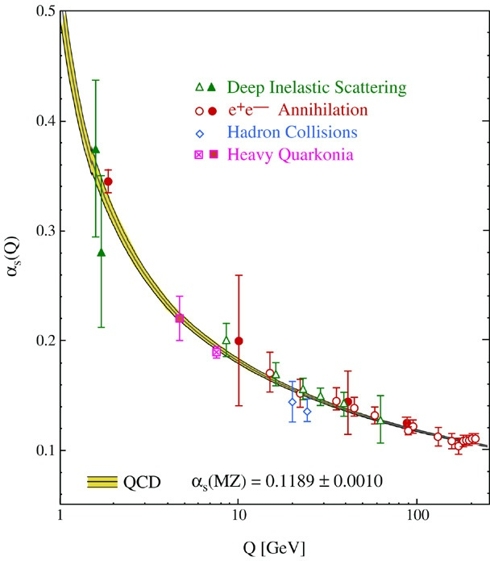
Strong-interaction: QCD
Asymptotically free
Perturbation theory is valid and accurate tool at large-Q²
Hence chiral limit is defined
Essentially nonperturbative
for Q² < 2 GeV²
Nature’s only example of truly nonperturbative,
fundamental theory
A-priori, no idea as to what such a theory
can produce

Slide 7
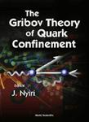
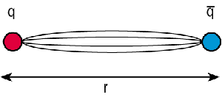
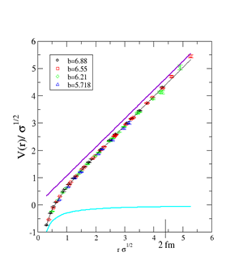
Confinement
X
Quark and Gluon Confinement
No matter how hard one strikes the proton, or any other hadron, one cannot liberate an individual quark or gluon
Empirical fact. However
There is no agreed, theoretical definition of light-quark confinement
Static-quark confinement is irrelevant to real-world QCD
There are no long-lived, very-massive quarks
Confinement entails quark-hadron duality; i.e., that all observable consequences of QCD can, in principle, be computed using an hadronic basis.

Slide 8
Confinement
G. Bali et al., PoS LAT2005 (2006) 308
“Note that the time is not a linear function of the distance but dilated within the string breaking region. On a linear time scale string breaking takes place rather rapidly. […] light pair creation seems to occur non-localized and instantaneously.”
Infinitely heavy-quarks plus 2 flavours with mass = m_{s}
Lattice spacing = 0.083fm
String collapses
within one lattice time-step
R = 1.24 … 1.32 fm
Energy stored in string at
collapse E_{c}^{sb} = 2 m_{s}
(mpg made via
linear interpolation)
No flux tube between
light-quarks
B_{s}
anti-B_{s}

Slide 9
Charting the interaction between light-quarks
This is a well-posed problem whose solution is an elemental goal of modern hadron physics.
The answer provides QCD’s running coupling.
Confinement can be related to the analytic properties of QCD's Schwinger functions.
Question of light-quark confinement can be translated into the challenge of charting the infrared behavior
of QCD's universal β-function
This function may depend on the scheme chosen to renormalise the quantum field theory but it is unique within a given scheme.
Of course, the behaviour of the β-function on the perturbative domain is well known.

Slide 10
Charting the interaction between light-quarks
Through QCD's Dyson-Schwinger equations (DSEs) the pointwise behaviour of the β-function determines pattern of chiral symmetry breaking.
DSEs connect β-function to experimental observables. Hence, comparison between computations and observations of
Hadron mass spectrum
Elastic and transition form factors
can be used to chart β-function’s long-range behaviour.
Extant studies show that the properties of hadron excited states are a great deal more sensitive to the long-range behaviour of the β-function than those of the ground states.

Slide 11
Confinement
Confinement is expressed through a violent change in the analytic structure of propagators for coloured particles & can almost be read from a plot of a states’ dressed-propagator
Gribov (1978); Munczek (1983); Stingl (1984); Cahill (1989);
Krein, Roberts & Williams (1992); …
Normal particle
Confined particle
complex-P²
complex-P²
Real-axis mass-pole splits, moving into pair(s) of complex conjugate poles or branch points
Spectral density no longer positive semidefinite
& hence state cannot exist in observable spectrum

Slide 12
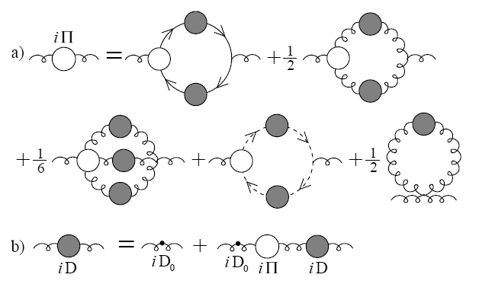
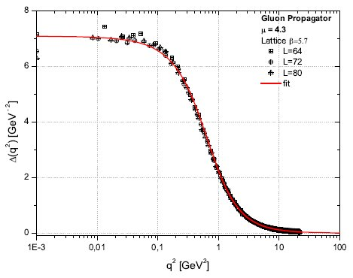
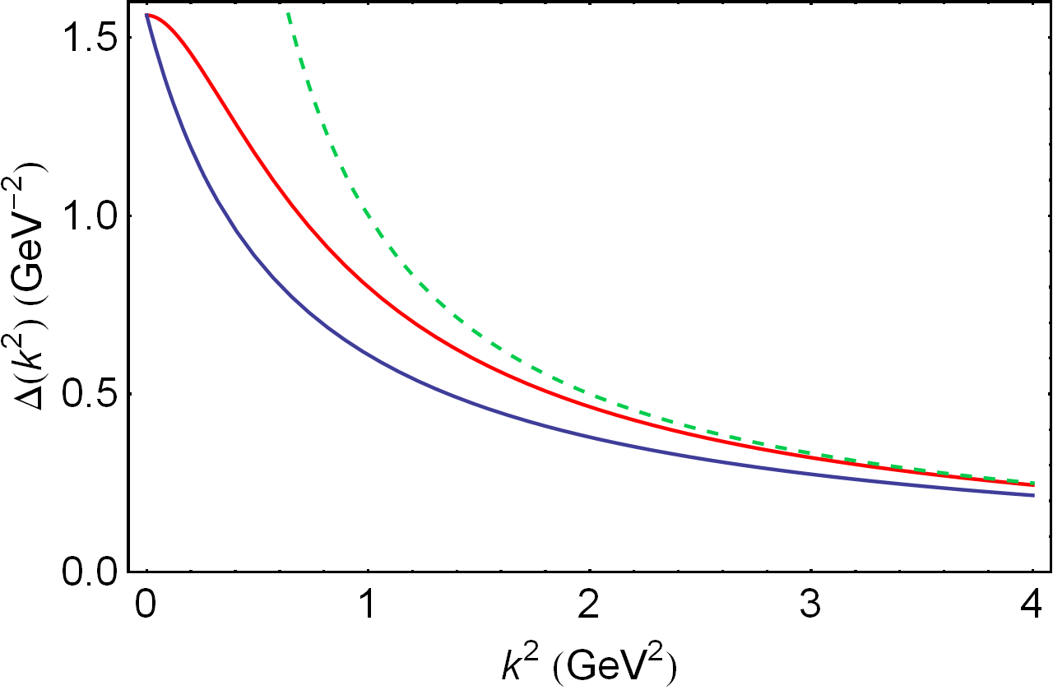
Dressed-gluon propagator
A.C. Aguilar et al., Phys.Rev. D80 (2009) 085018
Gluon propagator satisfies
a Dyson-Schwinger Equation
Plausible possibilities
for the solution
DSE and lattice-QCD
agree on the result
Confined gluon
IR-massive but UV-massless
m_{G} ≈ 2-4 Λ_{QCD}
IR-massive but UV-massless, confined gluon
perturbative, massless gluon
massive , unconfined gluon

Slide 13
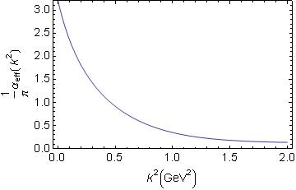
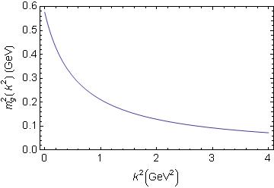
DSE Studies – Phenomenology of gluon
Maris & Tandy, Phys.Rev. C60 (1999) 055214
Wide-ranging study of π & ρ properties
Effective coupling
Agrees with pQCD in ultraviolet
Saturates in infrared
α(0)/π = 3.2
α(1 GeV²)/π = 0.35
Running gluon mass
Gluon is massless in ultraviolet
in agreement with pQCD
Massive in infrared
m_{G}(0) = 0.76 GeV
m_{G}(1 GeV²) = 0.46 GeV

Slide 14
Dynamical Chiral Symmetry Breaking
Strong-interaction: QCD
Confinement
Empirical feature
Modern theory and lattice-QCD support conjecture
that light-quark confinement is real
associated with violation of reflection positivity; i.e., novel analytic structure for propagators and vertices
Still circumstantial, no proof yet of confinement
On the other hand, DCSB is a fact in QCD
It is the most important mass generating mechanism for visible matter in the Universe.
Responsible for approximately 98% of the proton’s mass.
Higgs mechanism is (almost) irrelevant to light-quarks.

Slide 15
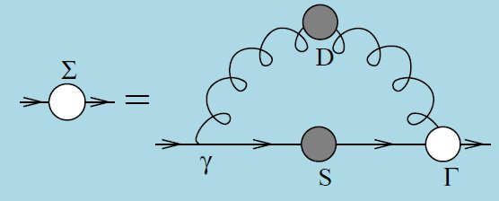
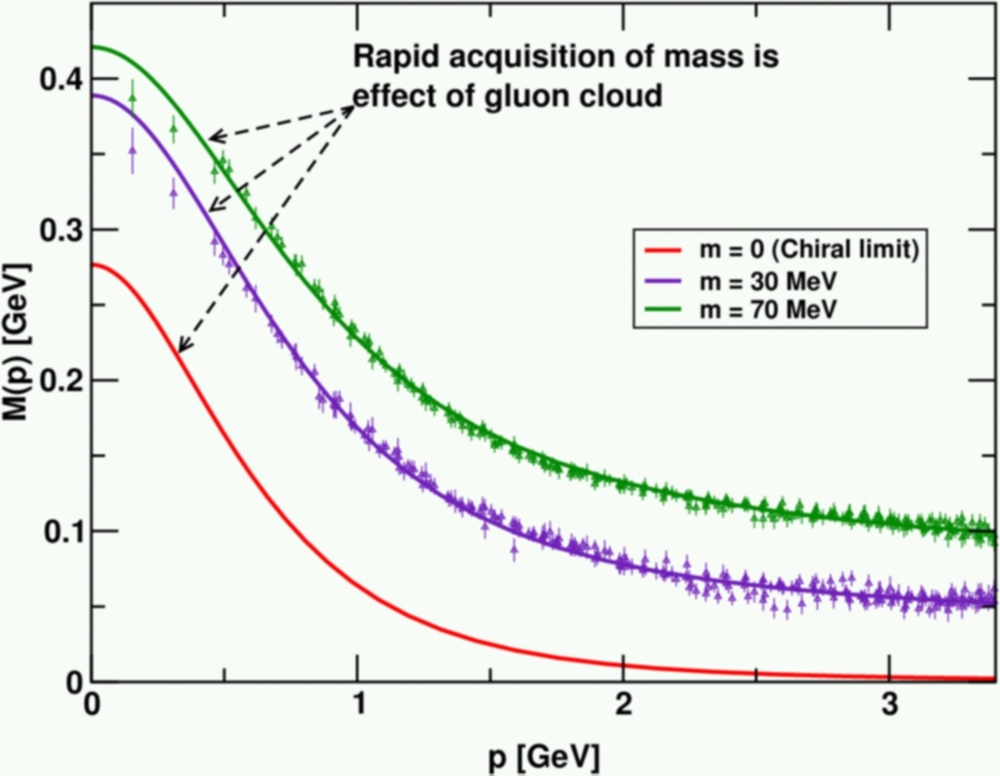
Frontiers of Nuclear Science: Theoretical Advances
In QCD a quark's effective mass depends on its momentum. The function describing this can be calculated and is depicted here. Numerical simulations of lattice QCD (data, at two different bare masses) have confirmed model predictions (solid curves) that the vast bulk of the constituent mass of a light quark comes from a cloud of gluons that are dragged along by the quark as it propagates. In this way, a quark that appears to be absolutely massless at high energies (m =0, red curve) acquires a large constituent mass at low energies.
C.D. Roberts, Prog. Part. Nucl. Phys. 61 (2008) 50
Notes:
(20)

Slide 16
Frontiers of Nuclear Science: Theoretical Advances
In QCD a quark's effective mass depends on its momentum. The function describing this can be calculated and is depicted here. Numerical simulations of lattice QCD (data, at two different bare masses) have confirmed model predictions (solid curves) that the vast bulk of the constituent mass of a light quark comes from a cloud of gluons that are dragged along by the quark as it propagates. In this way, a quark that appears to be absolutely massless at high energies (m =0, red curve) acquires a large constituent mass at low energies.
Mass from nothing!
DSE prediction of DCSB confirmed

Slide 17
Frontiers of Nuclear Science: Theoretical Advances
In QCD a quark's effective mass depends on its momentum. The function describing this can be calculated and is depicted here. Numerical simulations of lattice QCD (data, at two different bare masses) have confirmed model predictions (solid curves) that the vast bulk of the constituent mass of a light quark comes from a cloud of gluons that are dragged along by the quark as it propagates. In this way, a quark that appears to be absolutely massless at high energies (m =0, red curve) acquires a large constituent mass at low energies.
Hint of lattice-QCD support
for DSE prediction of violation of reflection positivity

Slide 18
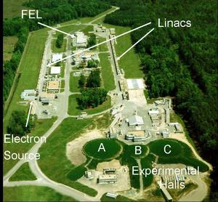
12GeV The Future of JLab
Numerical simulations of lattice QCD (data, at two different bare masses) have confirmed model predictions (solid curves) that the vast bulk of the constituent mass of a light quark comes from a cloud of gluons that are dragged along by the quark as it propagates. In this way, a quark that appears to be absolutely massless at high energies (m =0, red curve) acquires a large constituent mass at low energies.
Jlab 12GeV: Scanned by 2<Q²<9 GeV²
elastic & transition form factors.

Slide 19
Strong-interaction: QCD
Dressed-quark-gluon vertex
Gluons and quarks acquire momentum-dependent masses
characterised by an infrared mass-scale m ≈ 2-4 Λ_{QCD}
Significant body of work, stretching back to 1980, which shows that, in the presence of DCSB, the dressed-fermion-photon vertex is materially altered from the bare form: γ_{μ}.
Obvious, because with
A(p²) ≠ 1 and B(p²) ≠ constant,
the bare vertex cannot satisfy the Ward-Takahashi identity; viz.,
Number of contributors is too numerous to list completely (300 citations to 1st J.S. Ball paper), but prominent contributions by:
J.S. Ball, C.J. Burden, C.D. Roberts, R. Delbourgo, A.G. Williams,
H.J. Munczek, M.R. Pennington, A. Bashir, A. Kizilersu, L. Chang, Y.-X. Liu …

Slide 20
Dressed- quark-gluon vertex
Single most important feature
Perturbative vertex is helicity-conserving:
Cannot cause spin-flip transitions
However, DCSB introduces nonperturbatively generated structures that very strongly break helicity conservation
These contributions
Are large when the dressed-quark mass-function is large
Therefore vanish in the ultraviolet; i.e., on the perturbative domain
Exact form of the contributions is still the subject of debate but their existence is model-independent - a fact.

Slide 21
Gap Equation General Form
D_{μν}(k) – dressed-gluon propagator
Γ_{ν}(q,p) – dressed-quark-gluon vertex
Until 2009, all studies of other hadron phenomena used the leading-order term in a symmetry-preserving truncation scheme; viz.,
D_{μν}(k) = dressed, as described previously
Γ_{ν}(q,p) = γ_{μ}
… plainly, key nonperturbative effects are missed and cannot be recovered through any step-by-step improvement procedure
Bender, Roberts & von Smekal
Phys.Lett. B380 (1996) 7-12

Slide 22
Gap Equation General Form
D_{μν}(k) – dressed-gluon propagator
good deal of information available
Γ_{ν}(q,p) – dressed-quark-gluon vertex
Information accumulating
Suppose one has in hand – from anywhere – the exact form of the dressed-quark-gluon vertex
What is the associated symmetry-
preserving Bethe-Salpeter kernel?!
If kernels of Bethe-Salpeter
and gap equations don’t match,
one won’t even get
right charge for the pion.

Slide 23
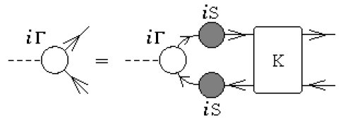
Bethe-Salpeter Equation Bound-State DSE
K(q,k;P) – fully amputated, two-particle irreducible,
quark-antiquark scattering kernel
Textbook material.
Compact. Visually appealing. Correct
Blocked progress for more than 60 years.

Slide 24
Bethe-Salpeter Equation General Form
Lei Chang and C.D. Roberts
0903.5461 [nucl-th]
Phys. Rev. Lett. 103 (2009) 081601
Equivalent exact bound-state equation but in this form
K(q,k;P) → Λ(q,k;P)
which is completely determined by dressed-quark self-energy
Enables derivation of a Ward-Takahashi identity for Λ(q,k;P)
Notes:
(30)

Slide 25
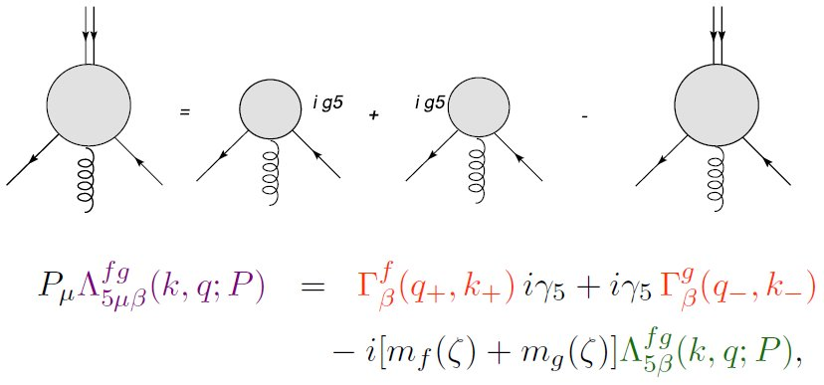
Ward-Takahashi Identity Bethe-Salpeter Kernel
Lei Chang and C.D. Roberts
0903.5461 [nucl-th]
Phys. Rev. Lett. 103 (2009) 081601
iγ₅
iγ₅
Now, for first time, it’s possible to formulate an Ansatz for
Bethe-Salpeter kernel given any form for the dressed-quark-gluon vertex by using this identity
This enables the identification and elucidation of a wide range of novel consequences of DCSB

Slide 26
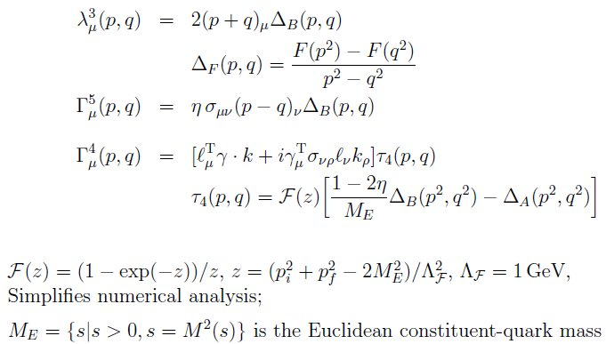
Dressed-quark anomalous magnetic moments
L. Chang, Y. –X. Liu and C.D. Roberts arXiv:1009.3458 [nucl-th]
Phys. Rev. Lett. 106 (2011) 072001
DCSB
Three strongly-dressed and essentially-
nonperturbative contributions to dressed-quark-gluon vertex:
Ball-Chiu term
Vanishes if no DCSB
Appearance driven by STI
Anom. chrom. mag. mom.
contribution to vertex
Similar properties to BC term
Strength commensurate with lattice-QCD
Skullerud, Bowman, Kizilersu et al.
hep-ph/0303176
Role and importance is
novel discovery
Essential to recover pQCD
Constructive interference with Γ⁵

Slide 27
Dressed-quark anomalous magnetic moments
L. Chang, Y. –X. Liu and C.D. Roberts arXiv:1009.3458 [nucl-th]
Phys. Rev. Lett. 106 (2011) 072001
Formulated and solved general
Bethe-Salpeter equation
Obtained dressed
electromagnetic vertex
Confined quarks
don’t have a mass-shell
Can’t unambiguously define
magnetic moments
But can define
magnetic moment distribution
Factor of 10
magnification
AEM is opposite in sign but of
roughly equal magnitude
as ACM
 | ME | κ^{ACM} | κ^{AEM}
Full vertex | 0.44 | -0.22 | 0.45
Rainbow-ladder | 0.35 | 0 | 0.048

Slide 28
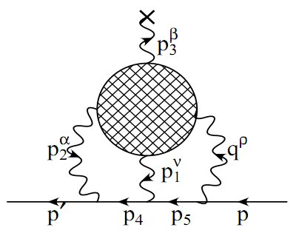
Dressed-quark anomalous magnetic moments
L. Chang, Y. –X. Liu and C.D. Roberts arXiv:1009.3458 [nucl-th]
Phys. Rev. Lett. 106 (2011) 072001
Formulated and solved general
Bethe-Salpeter equation
Obtained dressed
electromagnetic vertex
Confined quarks
don’t have a mass-shell
Can’t unambiguously define
magnetic moments
But can define
magnetic moment distribution
Factor of 10
magnification
Contemporary theoretical estimates:
1 – 10 x 10⁻¹⁰
Largest value reduces discrepancy expt.↔theory from 3.3σ to below 2σ.
Potentially important for elastic and transition form factors, etc.
Significantly, also quite possibly for muon g-2 – via Box diagram,
which is not constrained by extant data. (I.C. Cloët et al.)

Slide 29
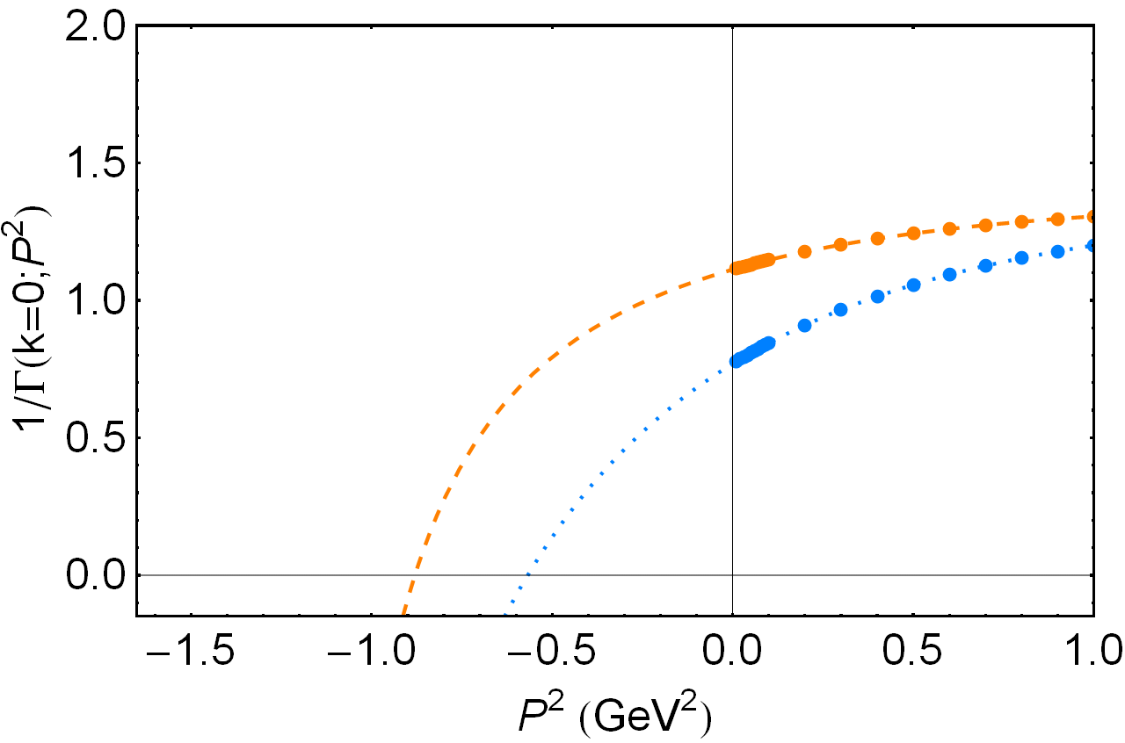
Dressed Vertex & Meson Spectrum
Location of zero
marks –m²_{meson}
 | Experiment | Rainbow-ladder | One-loop corrected | Ball-Chiu | Full vertex
a1 | 1230
ρ | 770
Mass splitting | 455
 | Experiment | Rainbow-ladder | One-loop corrected | Ball-Chiu | Full vertex
a1 | 1230 | 759 | 885
ρ | 770 | 644 | 764
Mass splitting | 455 | 115 | 121
Splitting known experimentally for more than 35 years
Hitherto, no explanation
Systematic symmetry-preserving, Poincaré-covariant DSE truncation scheme of nucl-th/9602012.
Never better than ∼ ⅟₄ of splitting
Constructing kernel skeleton-diagram-by-diagram,
DCSB cannot be faithfully expressed:
Full impact of M(p²)
cannot be realised!

Slide 30
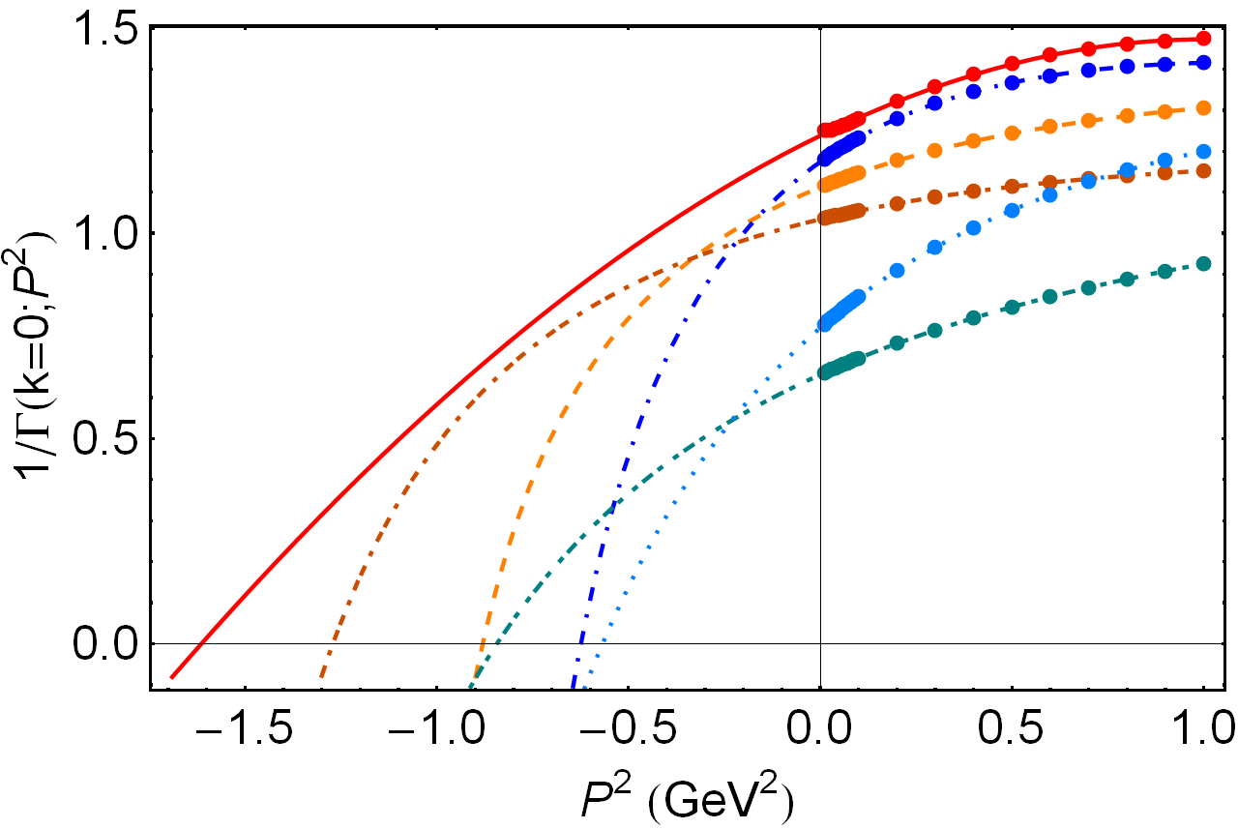
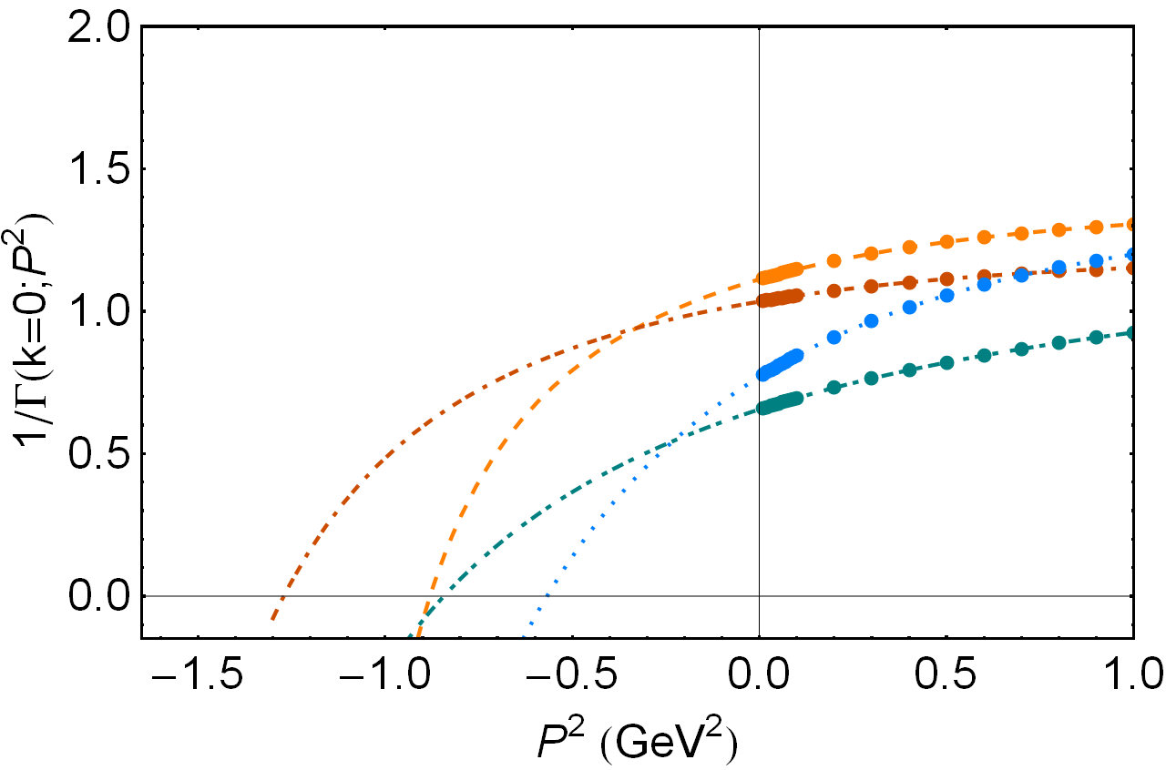
Dressed Vertex & Meson Spectrum
BC: zero moves deeper
for both ρ & a₁
Both masses grow
Full vertex:
zero moves deeper for a₁
but shallower for ρ
Problem solved
 | Experiment | Rainbow-ladder | One-loop corrected | Ball-Chiu | Full vertex
a1 | 1230 | 759 | 885 | 1066
ρ | 770 | 644 | 764 | 924
Mass splitting | 455 | 115 | 121 | 142
 | Experiment | Rainbow-ladder | One-loop corrected | Ball-Chiu | Full vertex
a1 | 1230 | 759 | 885 | 1128 | 1270
ρ | 770 | 644 | 764 | 919 | 790
Mass splitting | 455 | 115 | 121 | 209 | 480
Fully consistent treatment of Ball-Chiu vertex
Retain λ₃ – term but ignore Γ⁴ & Γ⁵
Some effects of DCSB built into vertex & Bethe-Salpeter kernel
Big impact on σ – π complex
But, clearly, not the complete answer.
Fully-consistent treatment of complete vertex Ansatz
Promise of 1st reliable prediction
of light-quark hadron spectrum
Lei Chang & C.D. Roberts, arXiv:1104.4821 [nucl-th]
Tracing massess of ground-state light-quark mesons

Slide 31
Unification of Meson & Baryon Spectra
Correlate the masses of meson and baryon ground- and excited-states within a single, symmetry-preserving framework
Symmetry-preserving means:
Poincaré-covariant & satisfy relevant Ward-Takahashi identities
Constituent-quark model has hitherto been the most widely applied spectroscopic tool; whilst its weaknesses are emphasized by critics and acknowledged by proponents, it is of continuing value because there is nothing better that is yet providing a bigger picture.
Nevertheless,
no connection with quantum field theory & therefore not with QCD
not symmetry-preserving & therefore cannot veraciously connect meson and baryon properties

Slide 32
Baryons
R.T. Cahill et al.,
Austral. J. Phys. 42 (1989) 129-145
Dynamical chiral symmetry breaking (DCSB)
– has enormous impact on meson properties.
Must be included in description and prediction of baryon properties.
DCSB is essentially a quantum field theoretical effect.
In quantum field theory
Meson appears as pole in four-point quark-antiquark Green function → Bethe-Salpeter Equation
Nucleon appears as a pole in a six-point quark Green function
→ Faddeev Equation.
Poincaré covariant Faddeev equation sums all possible exchanges and interactions that can take place between three dressed-quarks
Tractable equation is based on observation that an interaction which describes colour-singlet mesons also generates nonpointlike quark-quark (diquark) correlations in the colour-antitriplet channel
r_{qq} ≈ r_{π}

Slide 33
Faddeev Equation
R.T. Cahill et al.,
Austral. J. Phys. 42 (1989) 129-145
quark exchange
ensures Pauli statistics
quark
Linear, Homogeneous Matrix equation
Yields wave function (Poincaré Covariant Faddeev Amplitude) that describes quark-diquark relative motion within the nucleon
Scalar and Axial-Vector Diquarks . . .
Both have “correct” parity and “right” masses
In Nucleon’s Rest Frame Amplitude has
s−, p− & d−wave correlations
diquark
composed of strongly-dressed quarks bound by dressed-gluons

Slide 34
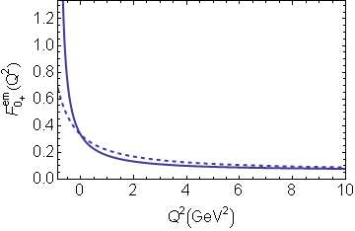
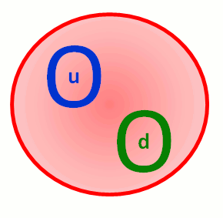
Diquarks in QCD
H.L.L. Roberts et al., 1102.4376 [nucl-th]
Phys. Rev. C in press
“Spectrum” of nonpointlike quark-quark correlations
Observed in
DSE studies in QCD
0⁺ & 1⁺ in Lattice-QCD
Scalar diquark form factor
r₀₊ ≈ r_{π}
Axial-vector diquarks
r₁₊ ≈ r_{ρ}
BOTH essential
Zero relation with old notion of pointlike constituent-like diquarks

Slide 35
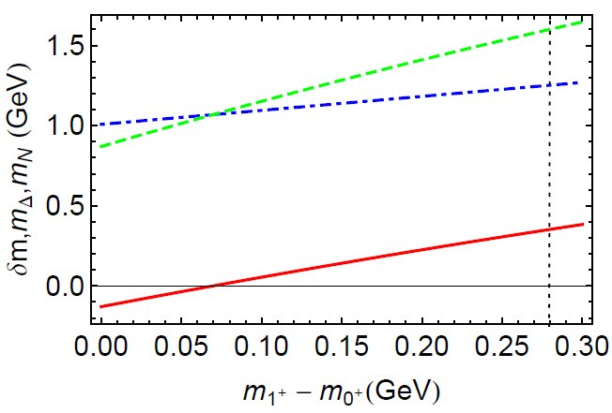
Baryons & diquarks
H.L.L. Roberts et al., 1102.4376 [nucl-th]
Phys. Rev. C in press
Provided numerous insights into baryon structure; e.g.,
There is a causal connection between m_{Δ} - m_{N} & m₁₊- m₀₊
m_{Δ}
m_{N}
Physical splitting grows rapidly with increasing diquark mass difference
m_{Δ} - m_{N}

Slide 36
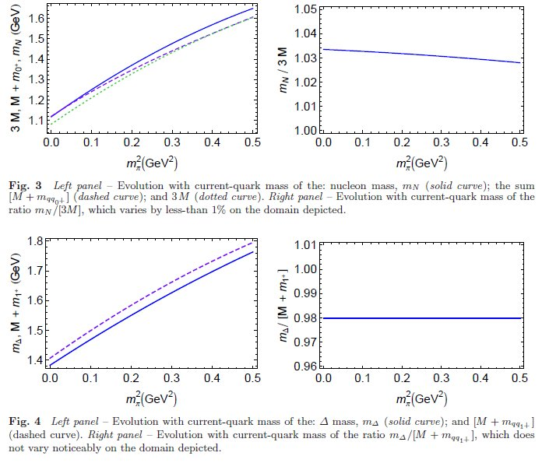
Baryons & diquarks
Provided numerous insights into baryon structure; e.g.,
m_{N} ≈ 3 M & m_{Δ} ≈ M+m₁₊

Slide 37
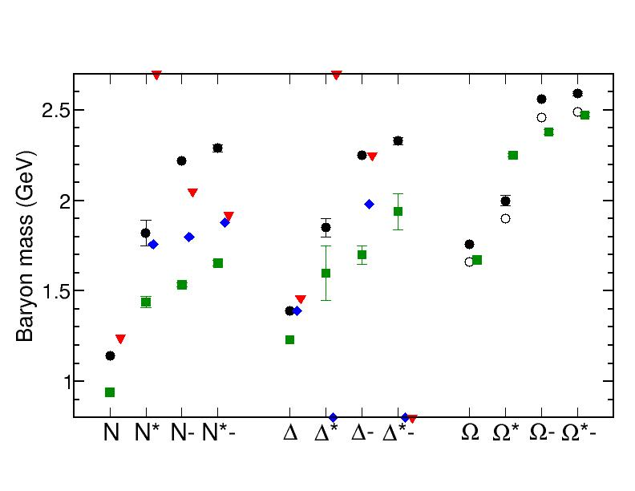
Hadron Spectrum
Legend:
Particle Data Group
H.L.L. Roberts et al.
EBAC
Jülich
Symmetry-preserving unification
of the computation of meson & baryon masses
rms-rel.err./deg-of-freedom = 13%
PDG values (almost) uniformly overestimated in both cases
- room for the pseudoscalar meson cloud?!

Slide 38
Baryon Spectrum
In connection with EBAC's analysis, dressed-quark Faddeev-equation predictions for bare-masses agree within rms-relative-error of 14%.
Notably, EBAC finds a dressed-quark-core for the Roper resonance, at a mass which agrees with Faddeev Eq. prediction.

Slide 39
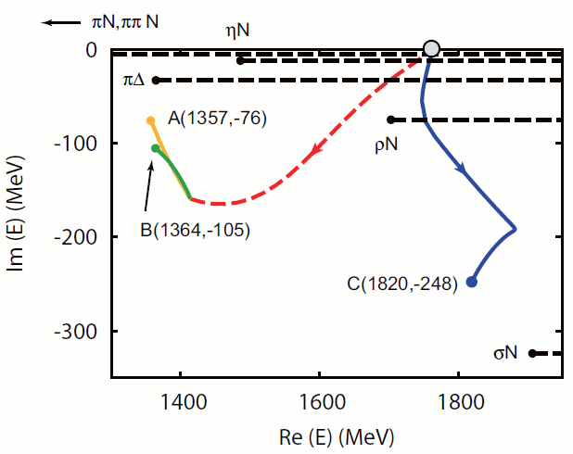
EBAC & the Roper resonance
N. Suzuki et al., Phys.Rev.Lett. 104 (2010) 042302
EBAC examined the dynamical origins of the two poles associated with the Roper resonance are examined.
Both of them, together with the next higher resonance in the P₁₁ partial wave were found to have the same originating bare state
Coupling to the meson-baryon continuum induces multiple observed resonances from the same bare state.
All PDG identified resonances consist of a core state and meson-baryon components.

Slide 40
Hadron Spectrum
Legend:
Particle Data Group
H.L.L. Roberts et al.
EBAC
Jülich
Now and for the foreseeable future, QCD-based theory will
provide only dressed-quark core masses;
EBAC or EBAC-like tools necessary for mesons and baryons

Slide 41
Performance Milestones
NSAC, www.sc.doe.gov/np/nsac/docs/PerfMeasEvalFinal.pdf
With resource commitment anticipated currently
HP3:
Complete the combined analysis of available data on single π, η, and K photo-production of nucleon resonances and incorporate the analysis of two-pion final states into the coupled-channel analysis of resonances
HP7:
Measure the electromagnetic excitations of low-lying baryon states (<2 GeV) and their transition form factors over the range
Q² = 0.1 – 7 GeV²
and measure the electro- and photo-production of final states with one and two pseudoscalar mesons.
EBAC was instituted in March 2006, charged with achieving these goals
– Completion: Spring 2012
– Completion & publication of reaction theory codes: end CY2013

Slide 42
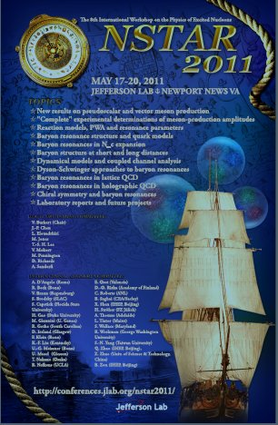
Epilogue
International Theory Effort is underway in support of N* Programme at 12 GeV
Goal to understand …
how the interactions between dressed–quarks
and –gluons create ground & excited nucleon states;
how these interactions emerge from QCD
No single approach is yet able to provide a unified description of all N* phenomena
Intelligent reaction theory will long be necessary as bridge between experiment and QCD-based theory
But, as seen in the one-day workshop preceding NStar2011:
Material progress since Beijing 2009, in developing strategies, methods, and approaches to the Physics of Nucleon Resonances

